Slide 1
DEFECT TRACKING SYSTEM
INFORMATION TECHNOLOGY
PRESENTED BY:
A VISWANATH (06A81A1259)
V V V D T DILIP KUMAR (06A81A1253)
Guided by:
K SHIRIN BHANU

Slide 2
Introduction
The Defect Tracking System (DTS) is a web based application that can be accessed throughout the Organization.
This project is aimed at developing an online defect tracking system useful for applications developed in an organization
This system can be used for logging defects against an application/module, assigning defects to individuals and tracking the defects to resolution.

Slide 3
Purpose Of The Project
The Defect Tracking Application allows you carry out four important tasks. They are
Finding bugs
Bugs reporting
About bugs
Application maintenance.
Each user should be assigned to at least one role so they can log in and perform one of the above tasks.

Slide 4
Problems In Existing System
Cannot Upload and Download the latest updates.
Risk of mismanagement of data when the project is under
development.
Less Security.
No proper coordination between different Applications and Users.
Fewer Users - Friendly.

Slide 5
Solutions Of These Problems
User friendliness is provided in the application with various controls.
The system makes the overall project management much easier and flexible.
There is no risk of data mismanagement at any level while the project development is under process.
It provides high level of security with different level of authentication.

Slide 6
Modules Of The System
Following tasks can be performed with the application:
User Maintenance
Component Maintenance
Defect Tracking
Report
Find User
Find component
Find defect
Send Defect Report
Check Defect Status

Slide 7
User Maintenance:
Creating, Granting & Revoking access and deleting users from application.
Component Maintenance:
Creating a component (application being developed/ enhanced), Granting & Revoking access on components to Users.

Slide 8
Defect Tracking:
Creating, Assigning defects to users, Modifying and Closing a defect. A defect screen should at least have following details and this defect report can be verified by concerned admin. After verify he can send the status to the users.
1.Defect Number and Title
2.Defect priority
3.Date created
4.Defect description
5.Name of originator
6.Status
Report:
Generate reports on defects.

Slide 9
Find User:
A search screen to find users and display results.
Find component:
A search screen to find components and display results.
Find defect:
A search screen to find defects and display results.
Send defect Report:
After finding the defect user can send defect report to the concerned administration.
Check Defect Status:
Once user send defect report he can able to check the status of the report.

Slide 10
Proposed system
To debug the existing system, remove procedures those cause data redundancy, make navigational sequence proper.
To provide information about audits on different level and also to reflect the current work status depending on organization/auditor or date.
To build strong password mechanism.

Slide 11
Need for Computerization
Facilitating desired information display, very quickly, by retrieving information from users.
Facilitating various statistical information which helps in decision-making?
To reduce manual efforts in activities that involved repetitive work.
Updating and deletion of such a huge amount of data will become easier.

Slide 12
Benefits
User is provided the option of monitoring the records he entered earlier. He can see the desired records with the variety of options provided by him.
Data storage and retrieval will become faster and easier to maintain because data is stored in a systematic manner and in a single database.
Easier and faster data transfer through latest technology associated with the computer and communication.
Through these features it will increase the efficiency, accuracy.

Slide 13
Limitations
The size of the database increases day-by-day, increasing the load on the database back up and data maintenance activity.
Training for simple computer operations is necessary for the users working on the system.

Slide 14
Use Case Diagrams

Slide 18
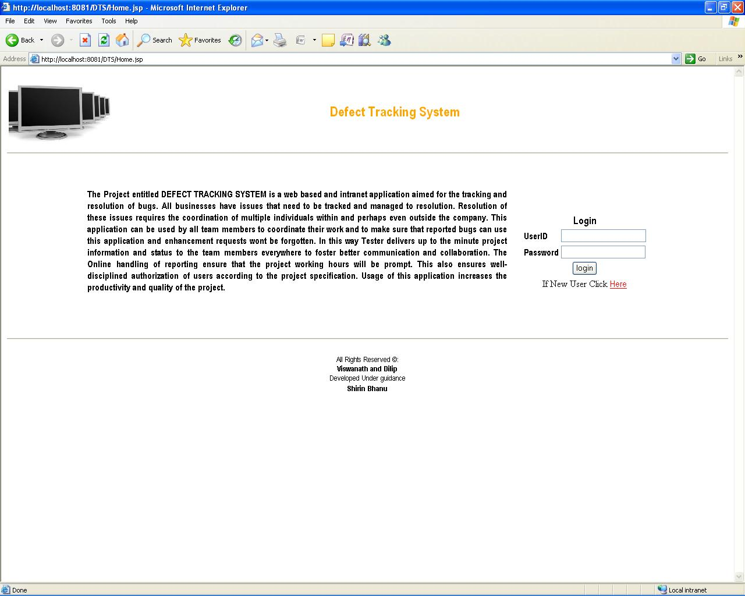
Output Screens
Home Page

Slide 19
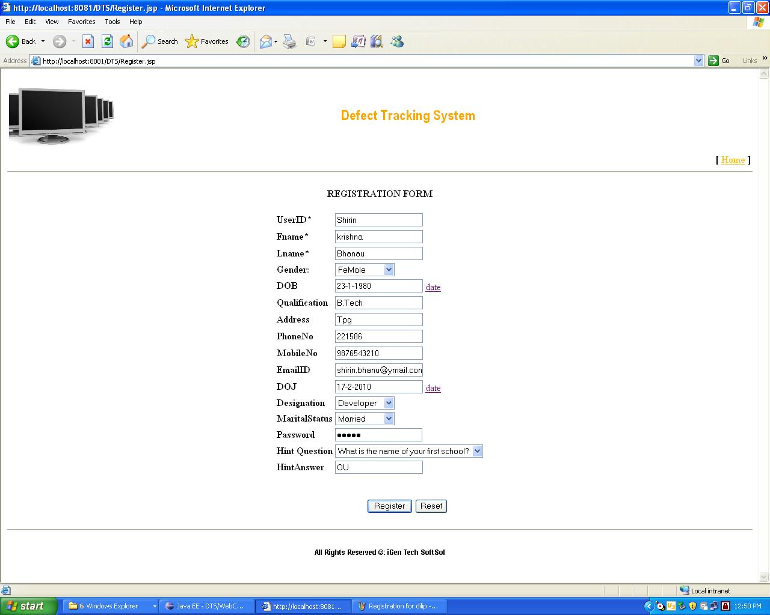
Registration Form

Slide 20
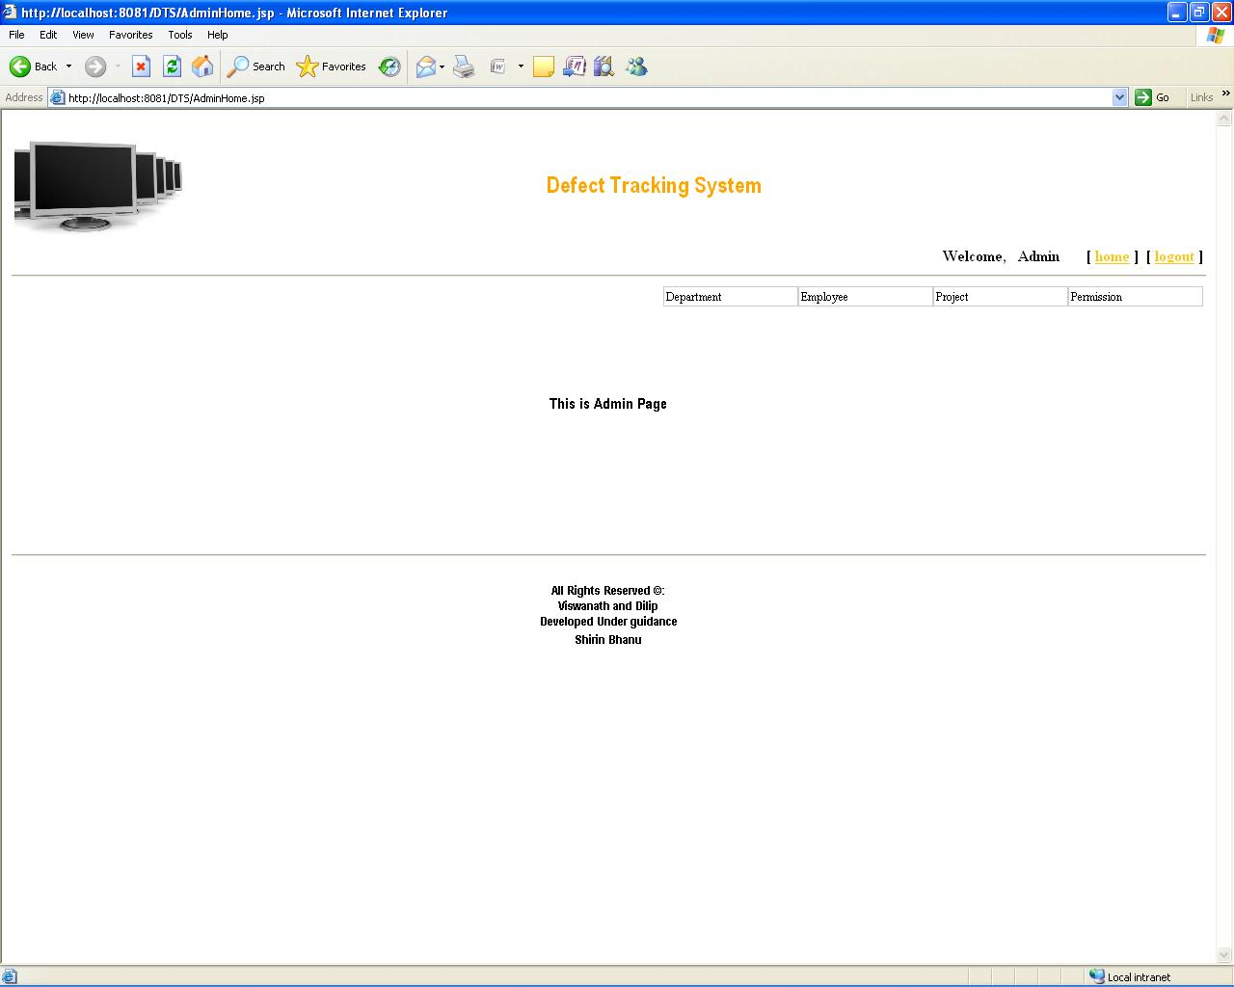
Admin home

Slide 21
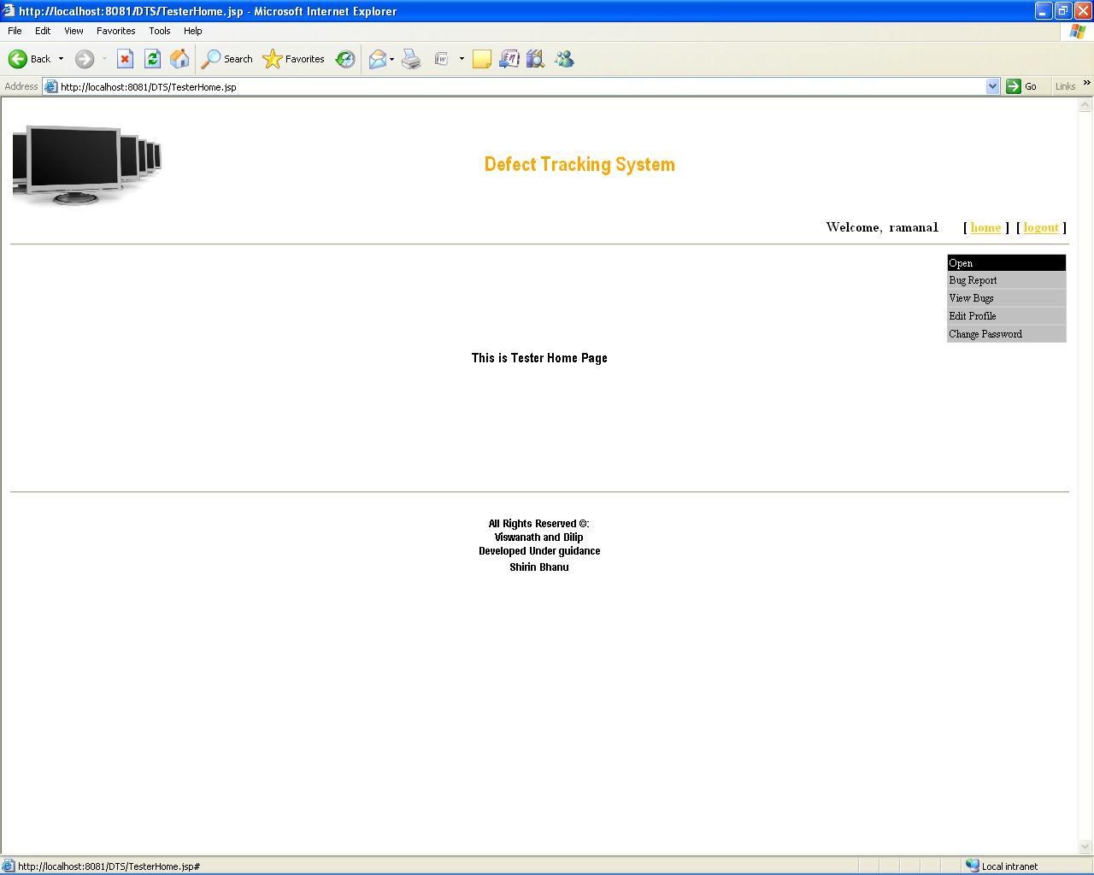
Tester Home

Slide 22

Developer home

Slide 23
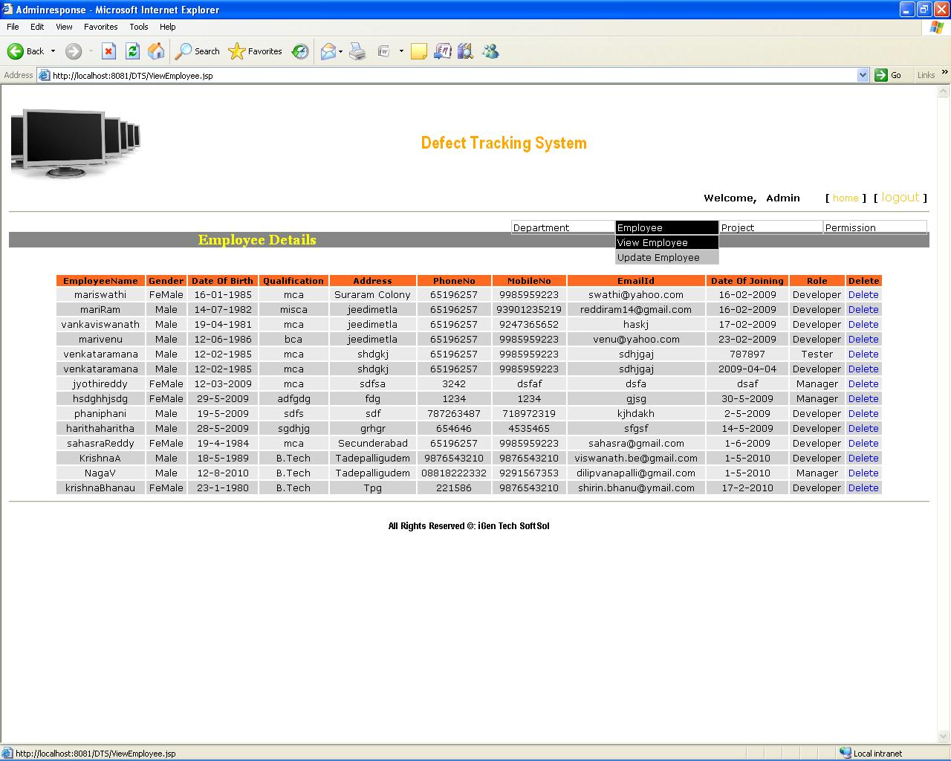
Admin view employee

Slide 24
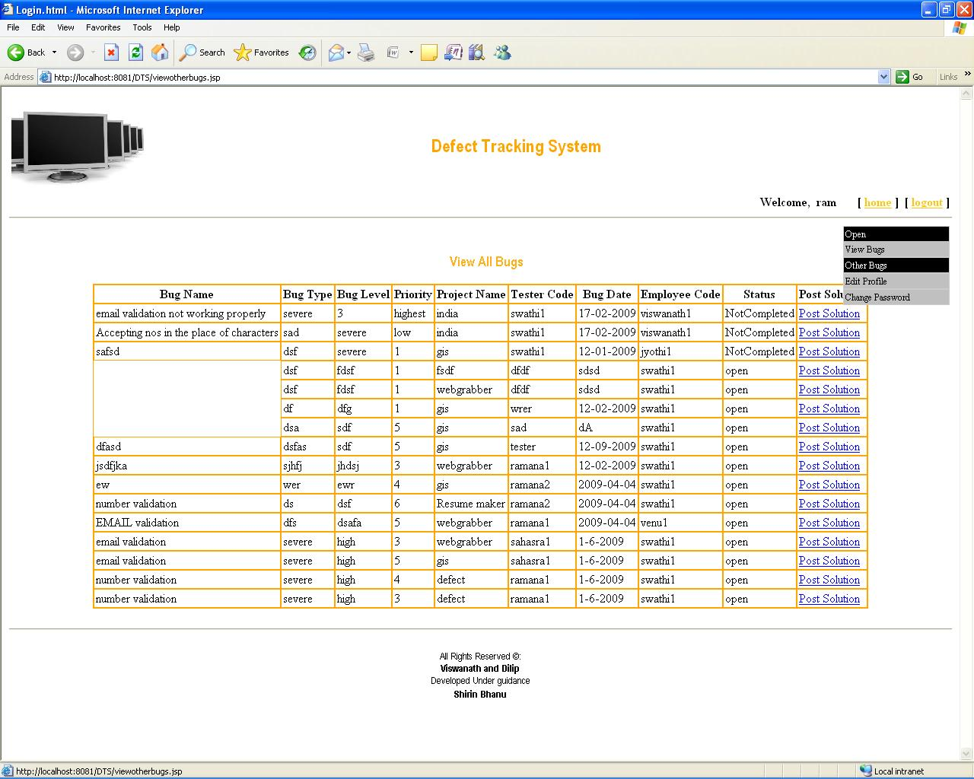
Tester view bugs

Slide 25
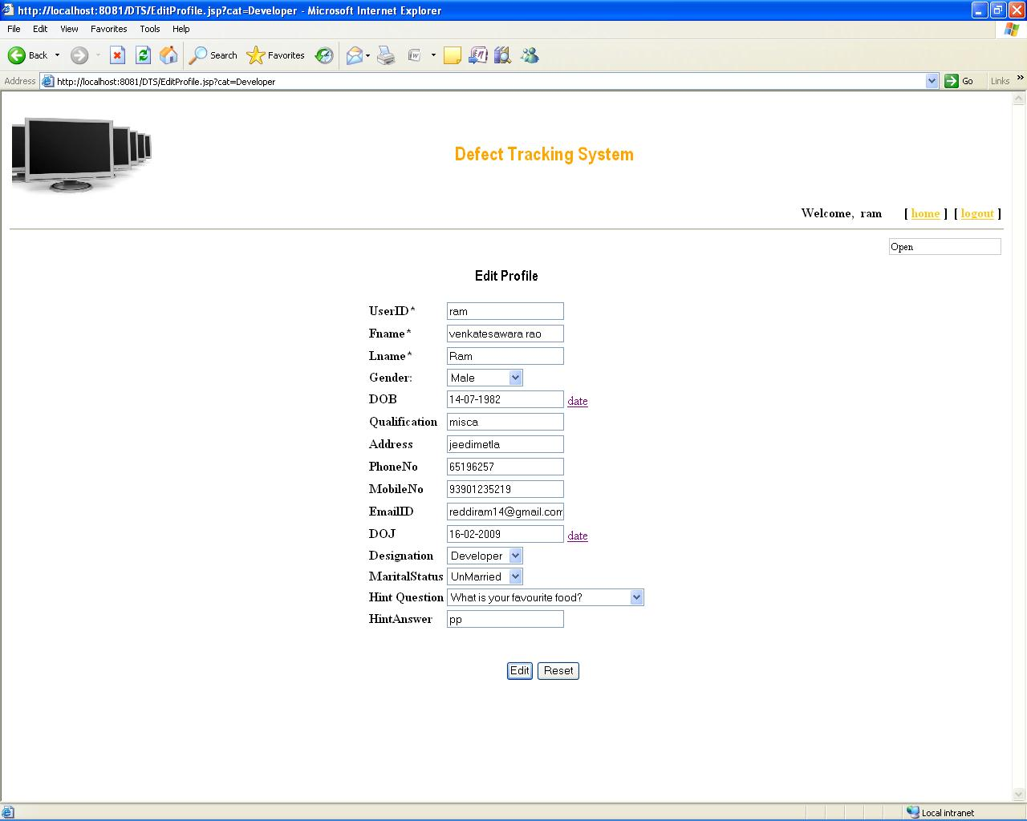
Edit profile

Slide 26
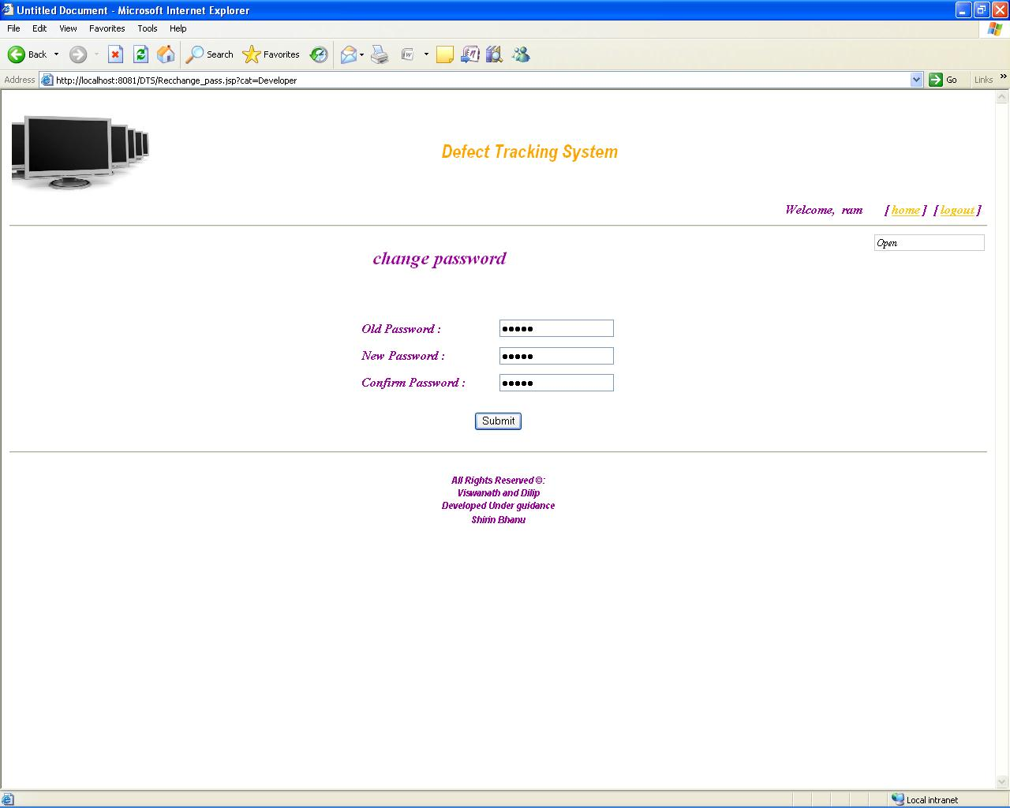
Change password

Slide 27
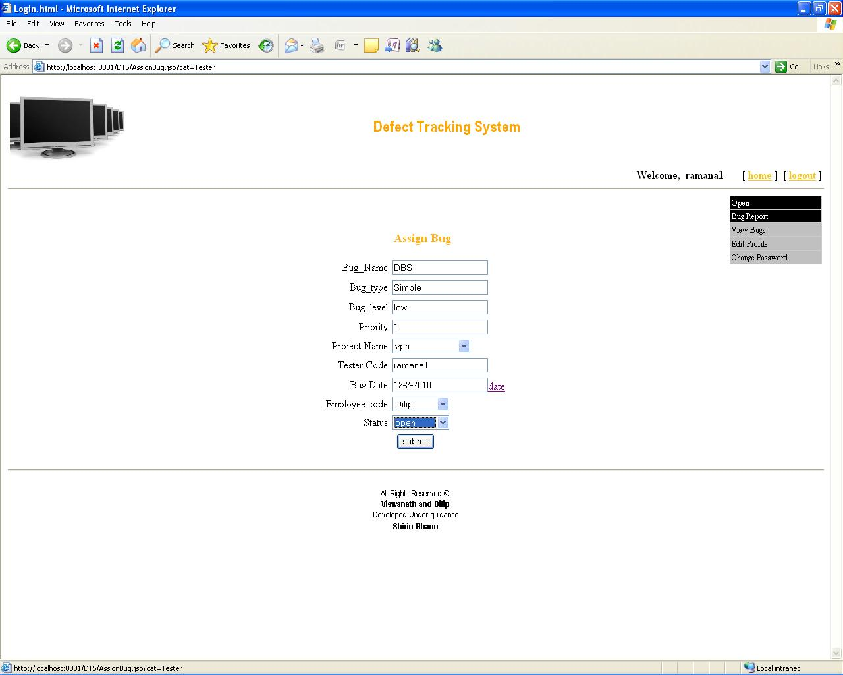
Developer bug report

Slide 28
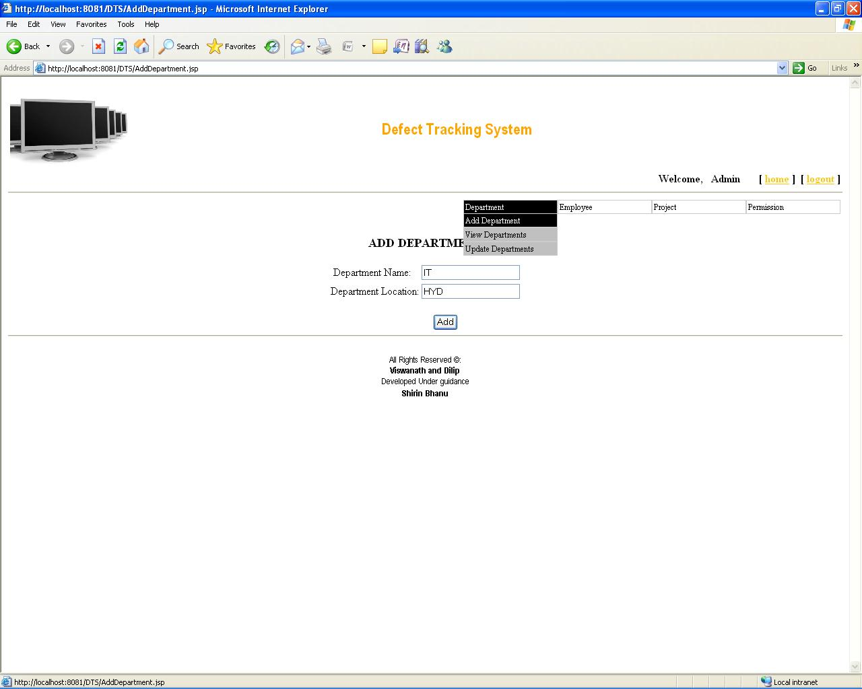
Admin add department

Slide 29
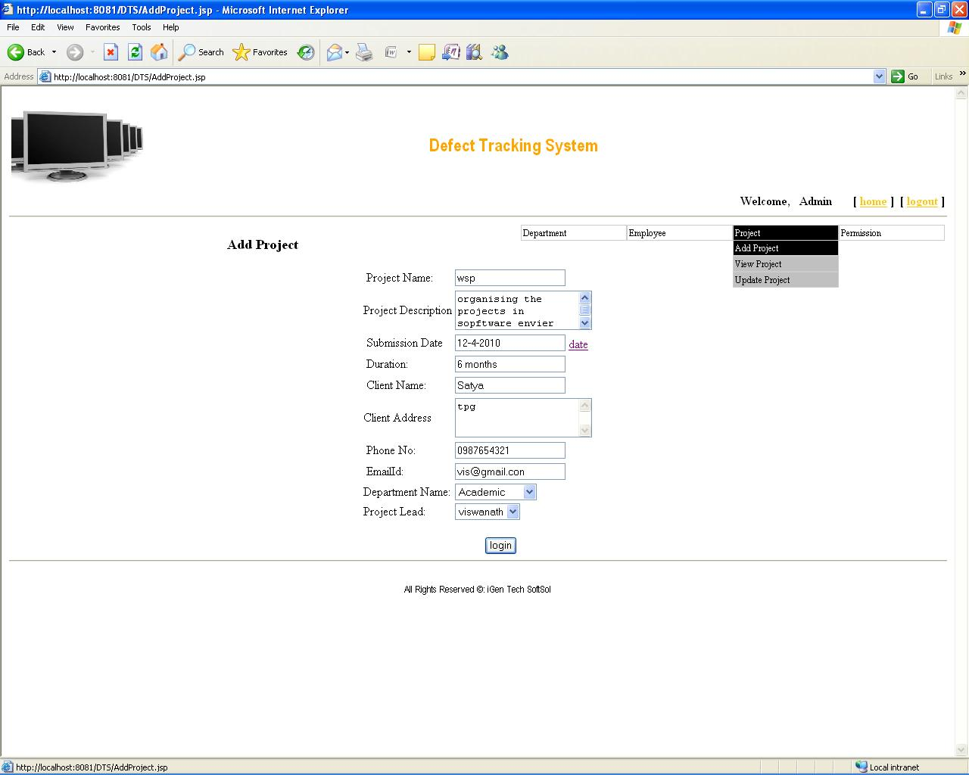
Admin add project

Slide 30
Conclusion
Web Enabled Defect Tracking System provides knowledge about the latest technology used in developing web enabled application and client server technology that will be great demand in future. This will provide better opportunities and guidance in future in developing projects independently.

Slide 31
References
www.wikipedia.com
www.freevideolectures.com

Slide 32
Thank Q

